Slide 1

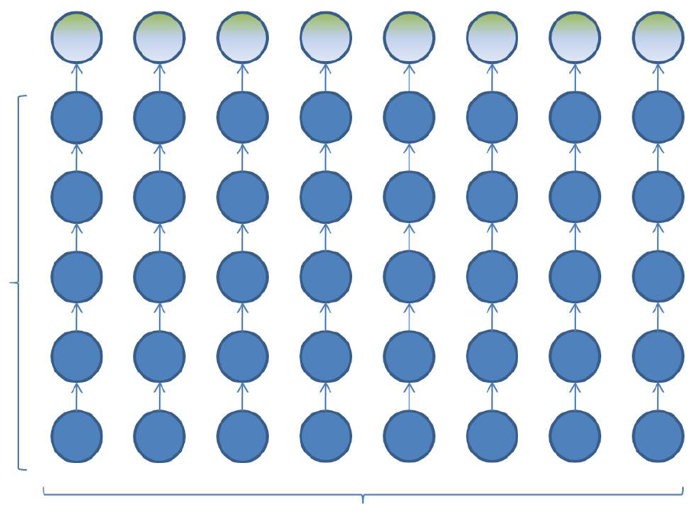
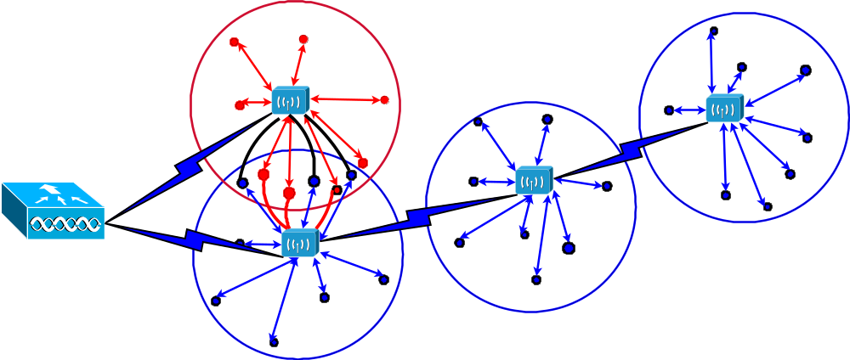
Linear Cluster Network
ETA
(TRANSDUCER
MOUNTING PLATE)
PRESSURE
BRICKS 78-83
PRESSURE
PRESSURE
BRICKS
BRICKS
04-11
12-20
SCUTR J
LASER
(OUTER)
BRICKS
SCUTR H
(OUTER)
(INNER)
SCUTR K
(INNER)
SLAVE
07
02
03
04
05
08
TAIL BEARING HOUSING
INTAKE
AND HOT NOZZLE.
Core
Engine
PRESSURE BRICKS
06
01-03, 21-23
CIRCLEX
AT
Ref: Distributed Engine Mounted Instrumentation Conditioning for more efficient engine development testing.
by Pete Loftus, Paul Carney, Phil Elliott, Andy McKinnon, James Roberts , 2008

Slide 2
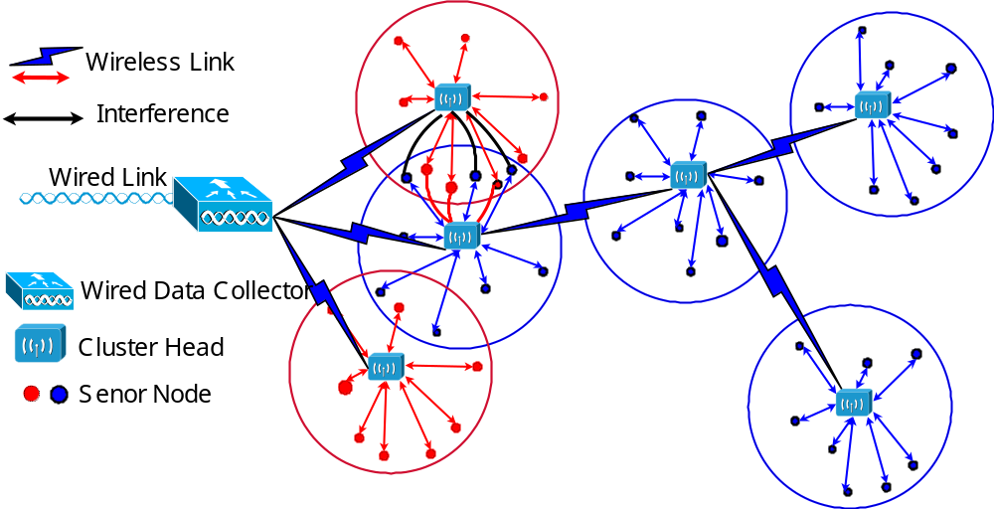
Possible WSN Structure in the future
Single hop within the cluster and multi-hop among the cluster-heads
Different node capabilities
Different design aims
3-step design procedure: 1. clustering, 2. scheduling and 3. routing
Notes:
Node types: Both Cluster Heads and Sensor Node are wireless nodes, but they have different level of power supply, computational abilities.
Communication Hops: The data transmission between a sensor node and its cluster-head is in a single-hop manner; However, the data transmission from a cluster-head to the Wired Data Collector will be in a multi-hop manner, due to the requirement of large network coverage and limited communication distance of cluster-head.
Node capabilities: (1) Wired Data Collector: with unlimited energy and high computational power; (2) Cluster-head: is less powerful with medium computational power, storage space and energy. They can take over some heavy duties such as polling, scheduling, routing, processing network information and interpreting data; The main objective of cluster-head design is to optmise the performance of the WSN; (3) Senor node: with limited energy and low computation ability. The main objective of sensor node design is to maximise the life-time of the node under limited energy.

Slide 3
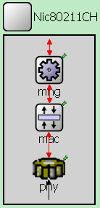
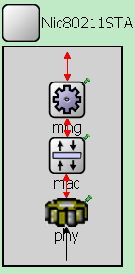
Cluster Management
Self-organisation (Cluster management)
Data / Control / Management Frames:
AssociationREQ
AssociationRES
DATA
ACK
DATA

Slide 4
Design Considerations on Interference
Two type of interference
intra-cluster: scheduling
inter-cluster:
a) cluster overlapping
b) nodes-to-head and head-to-head
joint scheduling & routing(cross-layer design)

Slide 5
Current Efforts
Aim: Develop an easy to use testbed for different MAC mechanisms
Currently Implementing a MAC independent PHY layer for CC2420 radio
Next steps:
  Test PHY (requires only two nodes)
  Implement and test MACs (requires at least 3, ideally > 10 nodes), organized at varying distances and clusters

